Slide 1


Slide 2

Operating Systems
Linux File Permissions

Slide 3
Linux File Permissions
Overview
By the end of this module you will be able to:
read the output of a long directory listing in Linux
read file and directory permissions
Describe and contrast file and directory permissions
set file and directory permissions
change file ownership

Slide 4
Linux File Permissions
Output of ls -l
A long directory listing (ls –l command) in Linux will allow you to see information about files and directories. The output will include:
File type
Permissions
Owner
Group
File size
File name
Timestamp of last access

Slide 5
Output from the ls – l command
To perform a long directory listing in Linux use the ls –l [path] command at the command prompt
The following is from of a long directory listing of the /etc directory
ls –l /etc

Slide 6
File Types
The first character identifies the file type
This can be one of the following:
Dash (-) indicates a regular file
d indicates a directory
c indicates a character special file such as a printer
b indicates a block character special file such as a disk
l indicates a symbolic or hard link

Slide 7
File Permissions
The next nine characters of the output of ls -l identify a file's permissions
remember, that a directory is just another type of file.
despite this, the meaning of individual permissions varies slightly depending on whether we're referring to a file or directory.
Permissions are set by a file's owner
A file’s initial owner is the user that created the file

Slide 8
Permission Sets
The nine characters identifying a files permissions are divided into three groups of three.
The first set of three characters identify the Owner permissions
The second set of three characters identify a file's Group permissions
The last set of three characters identify permissions applicable to all Other system users

Slide 9
Permission Sets
Each position within each set (where sets identify owner, group, other) have a very specific meaning:
the first position specifies Read permission
the second position specifies Write permission
the third position specifies Execute permission.
A dash ( - ) indicates that a specific permission is not set

Slide 10
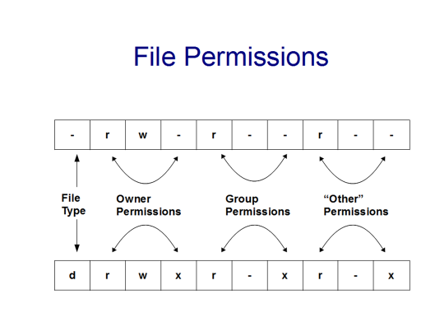
File Permissions

Slide 11
File Permissions
Permissions granted on a file will allow users the following access:
read ( r ): Gives the designated user the ability to open a file and look inside. Some commands that open a file and read its contents are more, less, cp, cat
write ( w ): Gives the designated user the ability to open the file and change its contents. Commands that open a file and write, or change its contents include vi and word processing applications

Slide 12
File Permissions (continued)
Permissions granted on a file will allow users the following access:
execute ( x ): Gives the designated user the ability to execute a file that is a correctly written shell script, or program
a dash ( - ) indicates that a particular permission is not granted

Slide 13
Directory Permissions
Permissions granted on a directory will allow users the following access:
read ( r ): Allows the user to list names of files stored in the directory
write ( w ): Allows the user to add or delete files in the specific directory

Slide 14
Directory Permissions (cont’d)
Permissions granted on a directory will allow users the following access:
execute ( x ): Allows the user to search in and change to the directory using the cd command. Without this permission, you cannot reach any file in a directory for any purpose
a dash ( - ) indicates that a particular permission is not granted

Slide 15
Changing Permissions
chmod [OPTION]... OCTAL-MODE FILENAME...
OCTAL-MODE is defined as the sum of:
r = 4
w = 2
x = 1
- = 0
for each set of permissions.
FILENAME is the file or files on which to apply the change in permissions

Slide 16
Setting Permissions Examples
Create a file called chmod-test using the touch command and set the following permissions:
read, write, and execute for owner (Octal: 4+2+1=7)
read and execute for group and other (Octal: 4+1=5)
touch chmod-test ; chmod 755 chmod-test ; ls -l
We now want to grant full access to test-file for all system users. We would execute the command:
chmod 777 chmod-test ; ls -l chmod-test

Slide 17
Setting Permissions Examples
To revoke all permissions we would execute:
chmod 000 chmod-test ; ls -l chmod-test
To restore its original permissions we would execute:
chmod 755 chmod-test ; ls -l chmod-test

Slide 18
Changing File Ownership
File ownership can be reassigned by using the chown command
chown [OPTION]... [OWNER][:[GROUP]] FILE...
A file’s original owner is the person who created it
Use of the chown command is usually restricted to the root user on newer Linux systems

Slide 19
Changing File Ownership
Example
Create a file, display the ownership and change its ownership to the root user
touch chown-test ; ls -l chown-test
chown root chown-test
su ; chown root chown-test ; ls -l chown-test
If you have sudo configured, the command would be:
sudo chown root chown-test

Slide 20
Changing Group Ownership
As shown below, you may change group ownership at the same time using the chown command
chown root.root chown-test ; ls -l chown-test
Or you can use the chgrp command to only change the group.
chgrp [OPTION]... GROUP FILE...
Use of these commands is usually restricted to the root user on newer Linux systems

